Slide 1
ISON network development in 2015 - 2016
Igor Molotov
Roscosmos delegation
KIAM RAS
IADC 35th Darmstadt, Germany ― WG1
April 24 – 26, 2017

Slide 2
International Scientific Optical Network (ISON)
ISON is an open international project that cooperates with 38 observation facilities of various affiliation with 90 telescopes in 16 countries.
Keldysh Institute of Applied Mathematics of the Russian Academy of Sciences (KIAM) coordinates the ISON project, maintains space objects database of Russian Academy of Sciences/Federal Agency for Scientific Organizations and provides conjunction analysis for Russian satellites at high orbits under order of Roscosmos
ISON represents now interagency association that includes the 4 segments – scientific cooperation, Roscosmos, industry organizations and new one for commercial activities

Slide 3
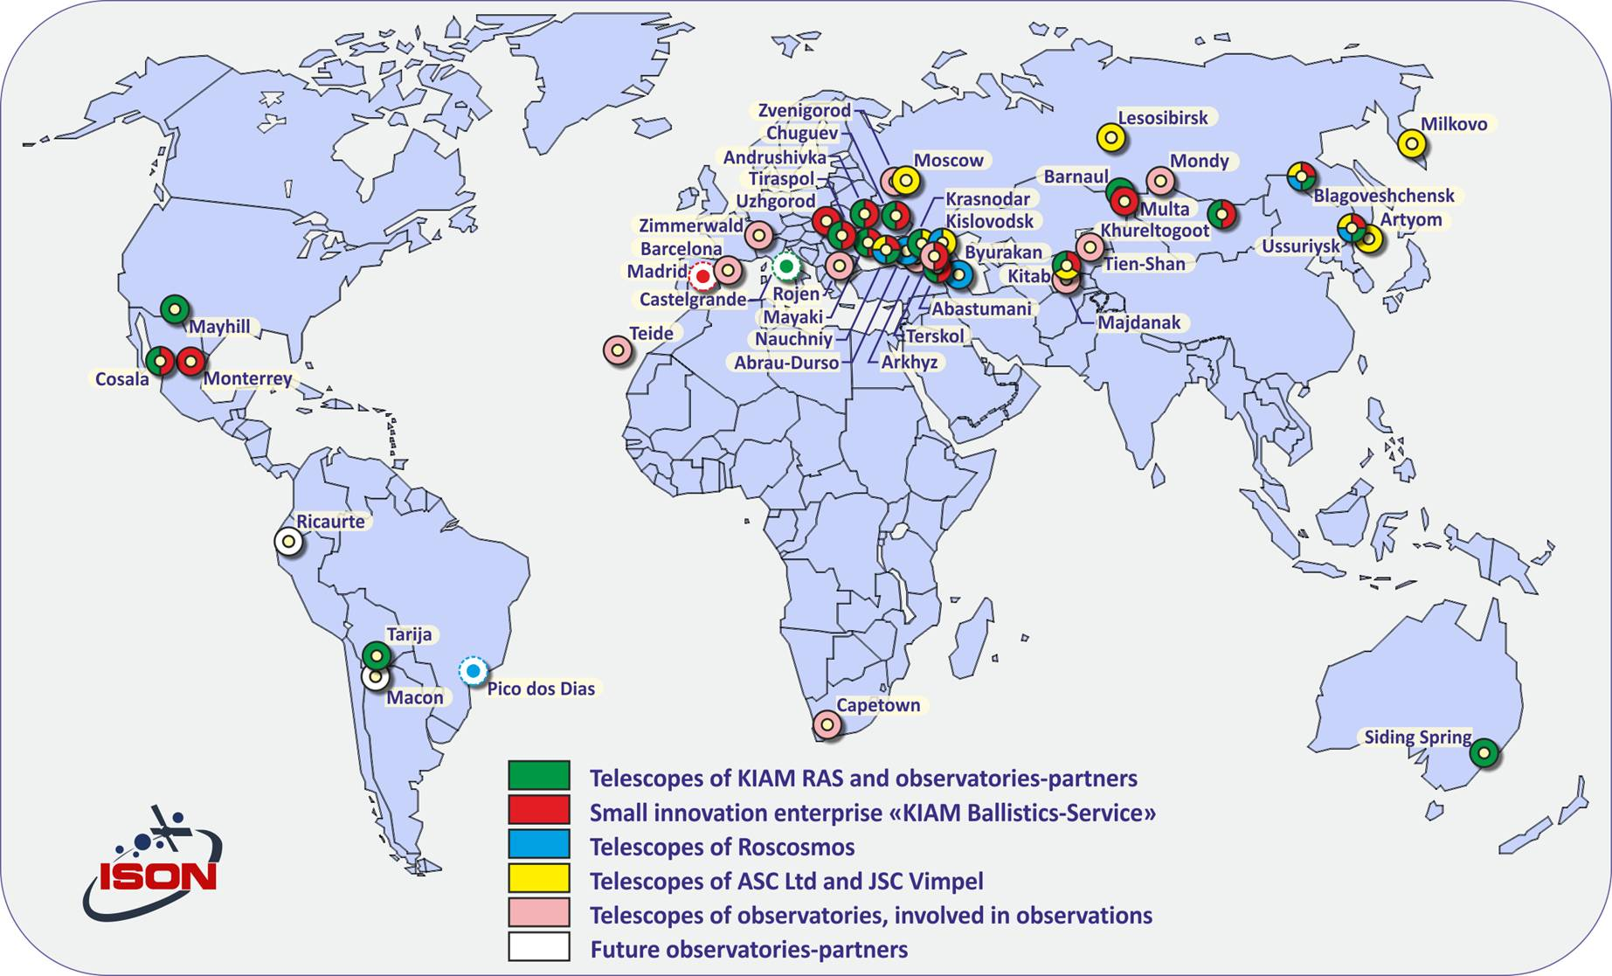
Map of observatories that send the data to KIAM

Slide 4
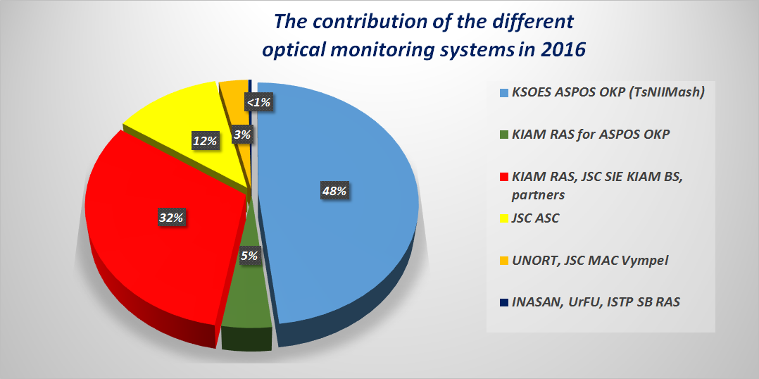
Segments of telescopes that send the data to KIAM
26 telescopes of KIAM international cooperation for scientific researches
24 telescopes of «Small innovation enterprise «KIAM Ballistics-Service» for usage in commercial aspects
22 telescopes of the Roscosmos/TsNIIMash (6 observatories EOP-1, EOP-2 + 4 pcs.) to support the conjunction analysis
18 telescopes of JSC MAC Vympel and JSC ASC in interests of space situation analysis

Slide 6
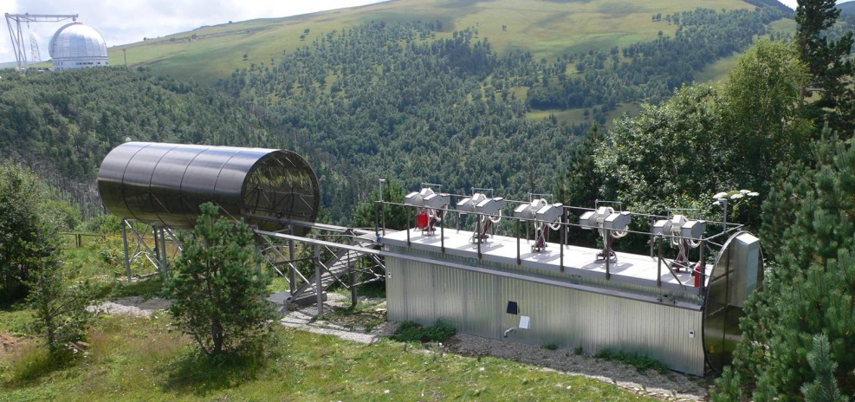
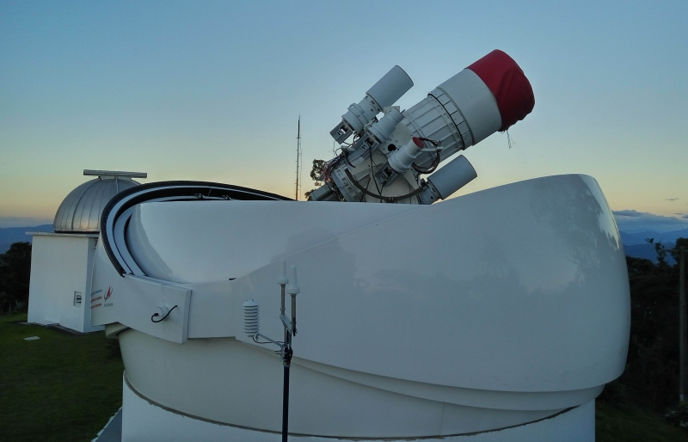
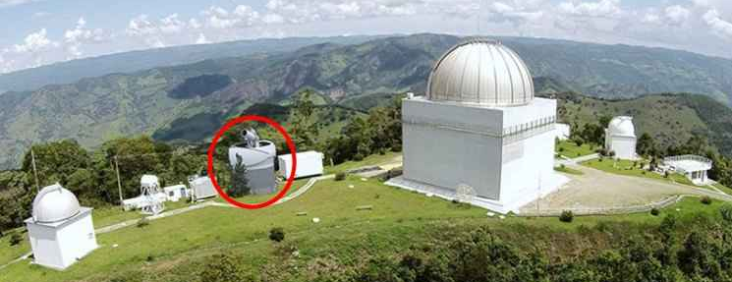
Development of Roscosmos segment: 1.6 m AZT-33VM in Mondy, Sayan mountains ; MMT-9 in Arkhyz, North Caucasus, 75-cm Sova-75 in Itajuba, Brazil

Slide 7
Development of Roscosmos segment
Observatory | Telescope | Field of view | Mode
Mondy, Siberia | 1.6 m AZT-33VM | 30x30 minutes 3 degree on 300 mm | Astrometry/CCD photometry
Arkhyz, Caucasus | 7x9 cm MMT-9 | 30x30 degree | Fast photometry 10 Hz
Itajuba, Brazil | 75 cm Sova-75 25 cm x 2 Sova-25 5 cm x 2 Sova-5 | 4.8x5.4 degree 7x7 degree 28x28 degree | GEO HEO LEO

Slide 8
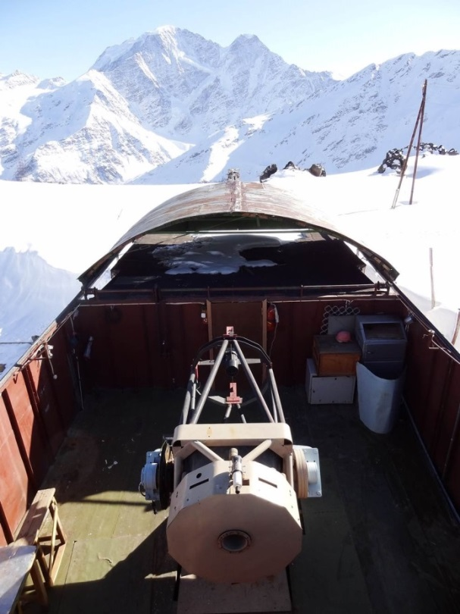
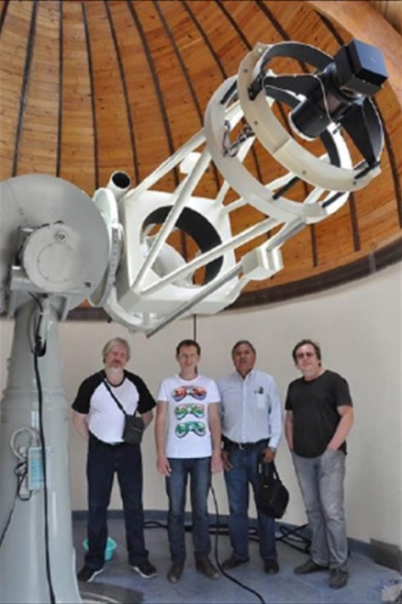
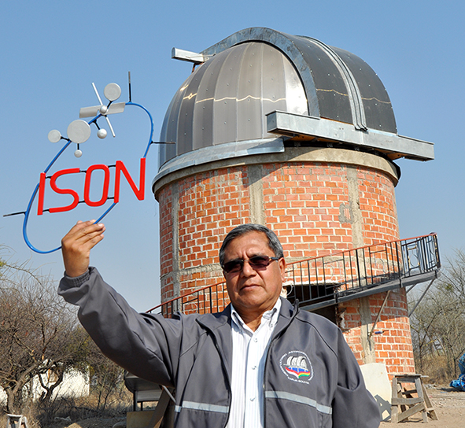
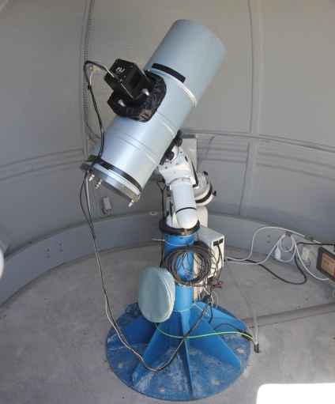
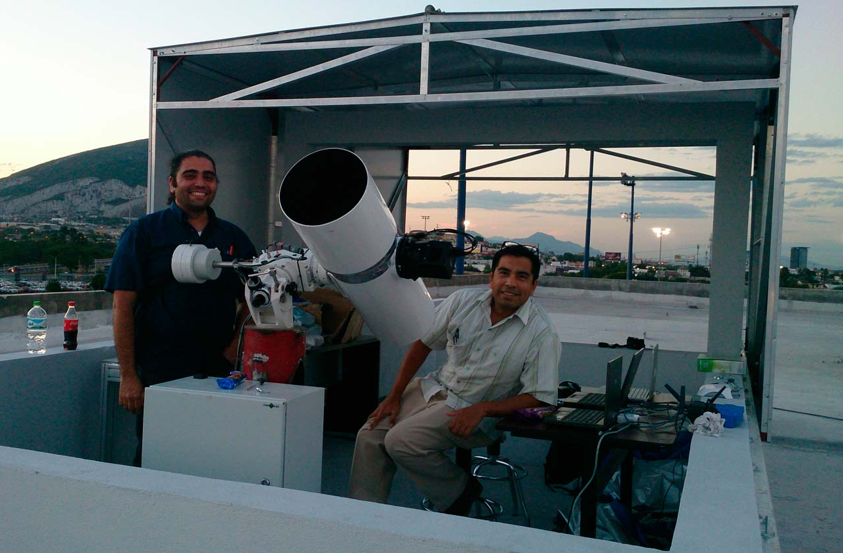
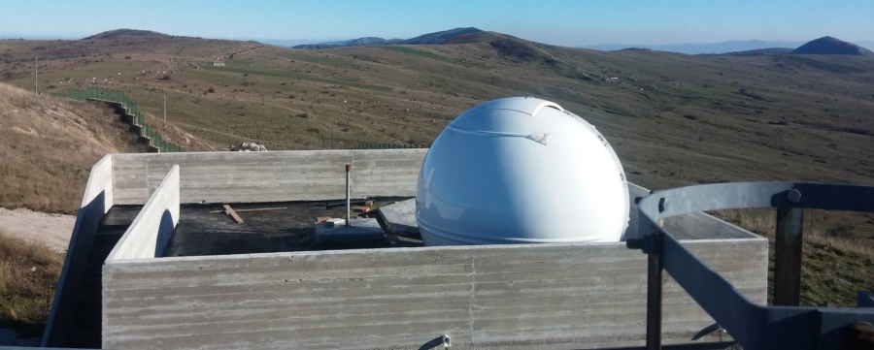
Development of scientific ISON segment: 80 cm K-800 at Terskol, N.Caucasus; 60 cm Ceiss-600 in Tarija, Bolivia; 22 cm ORI-22 in Castelgrande, Italy; 25 cm ORI-25 in Monterrey, Mexico

Slide 9
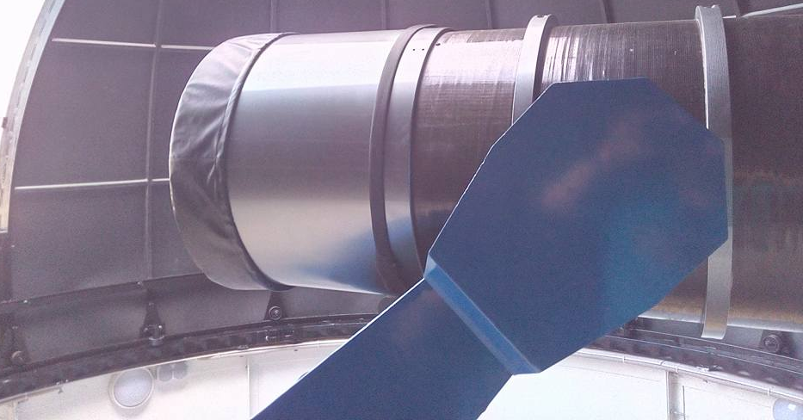
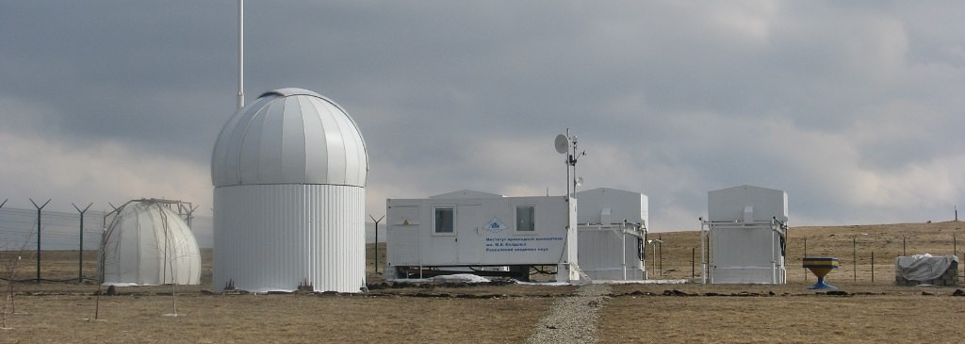
Development of industry organization ISON segment
Observatory | Telescope | Field of view | Mode
Kislovodsk, North Caucasus | 50 cm ORI-50ML | 2x2 degree on 36-mm CCD chip | deep GEO survey (down to 17^{m})
Nauchny-3, Crimea | 30 cm GenonMax | 4.7x4.7 degree | GEO survey

Slide 10
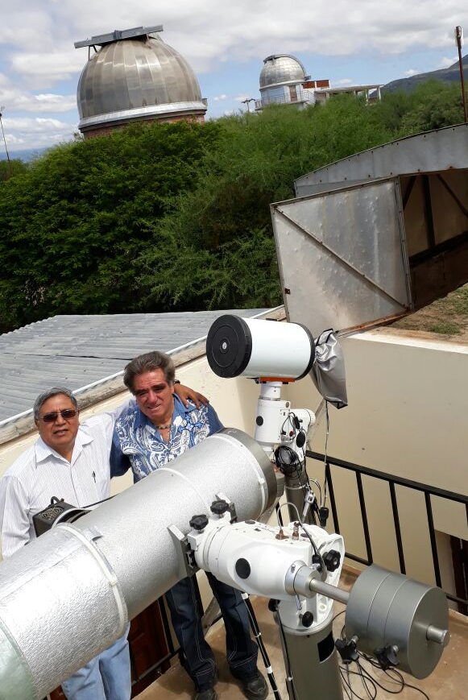
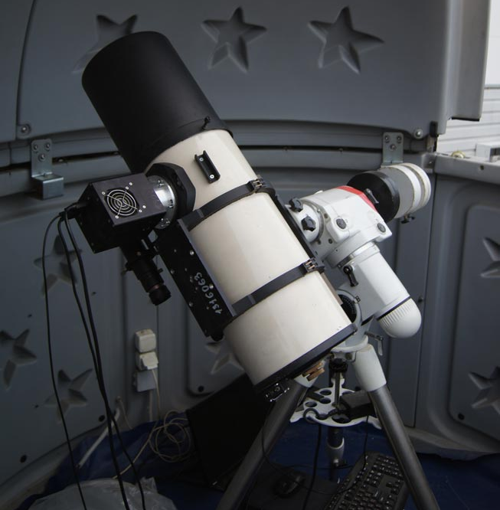
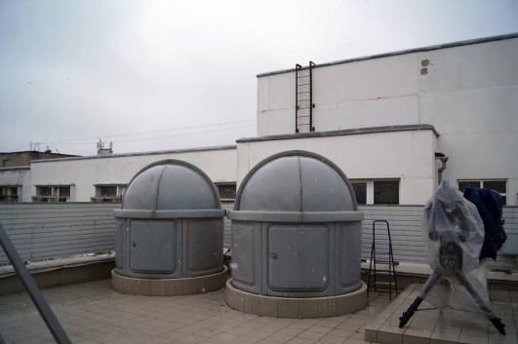
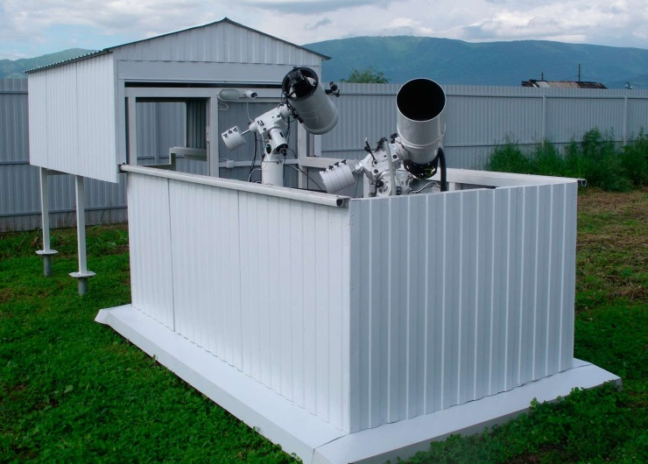
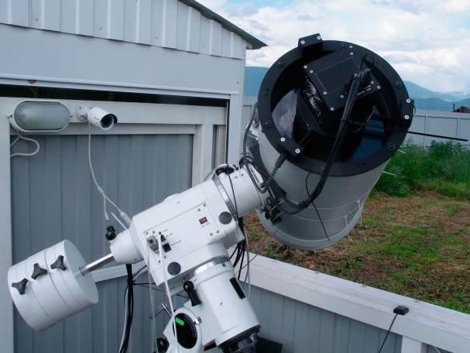
Development of segment of the ISON for “commercial” observations 25 cm TAL-250 in Tarija, Bolivia; 25 cm TAL-250 in Barnaul, Altay region, Russia, 18 cm GAM-180 in Krasnodar, Russi; 22 cm SHS-22 in Multa, Altay republic, Russia

Slide 11
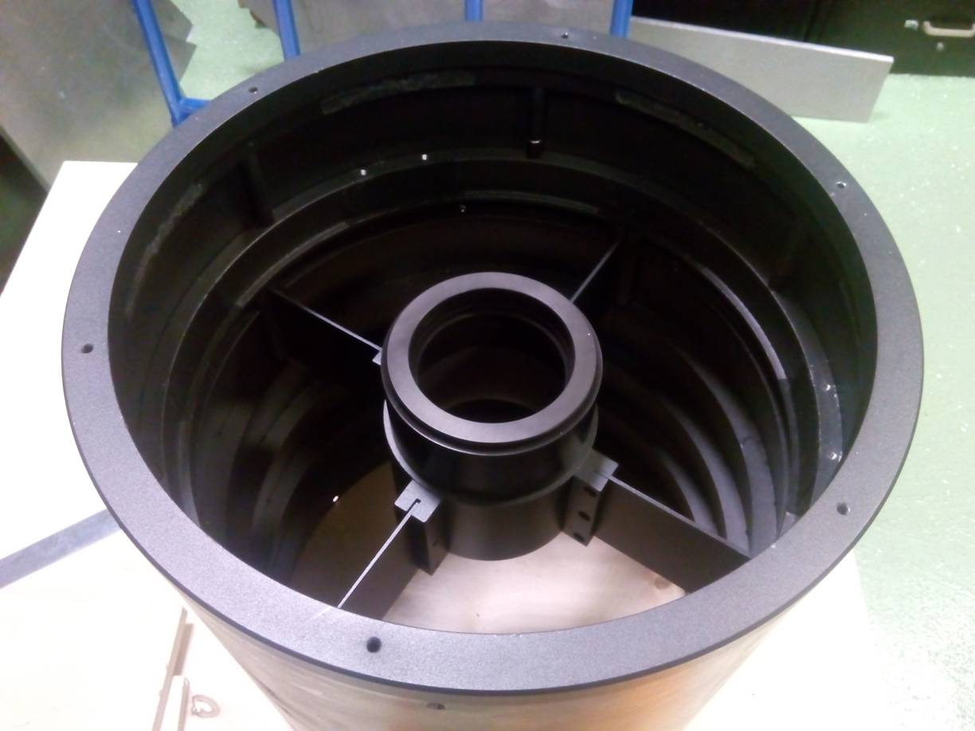
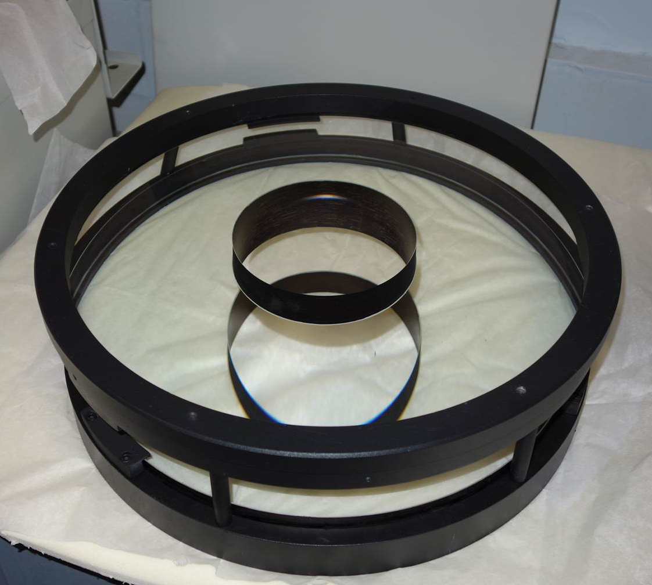
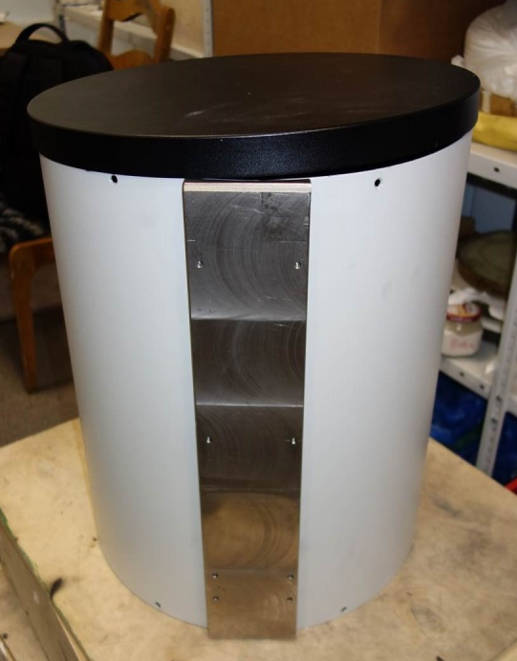
Details of new 40-cm telescope with FOV of 5.5x5.5 degree. Fist test is planned in May 2017
Two images of tube, full aperture lens corrector, mirror

Slide 12
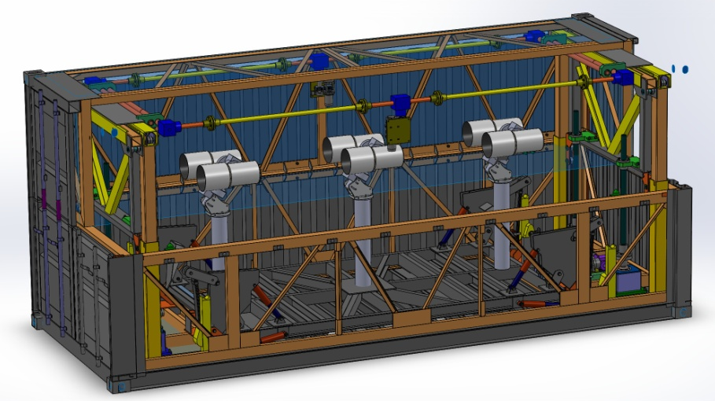
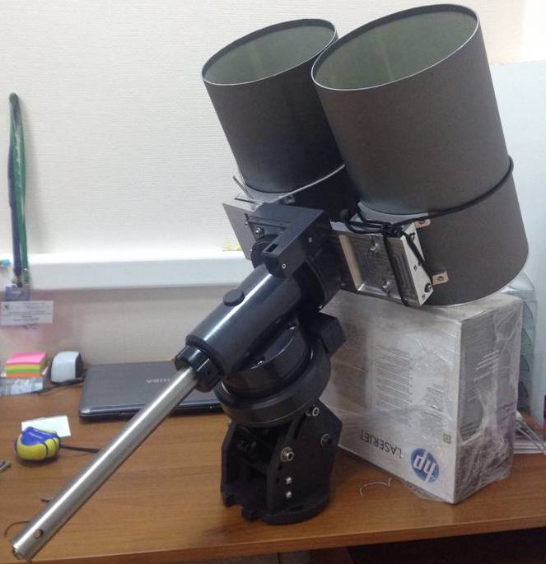
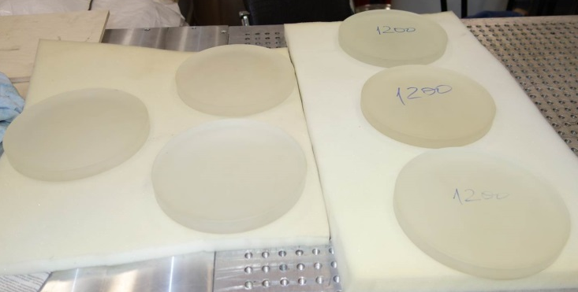
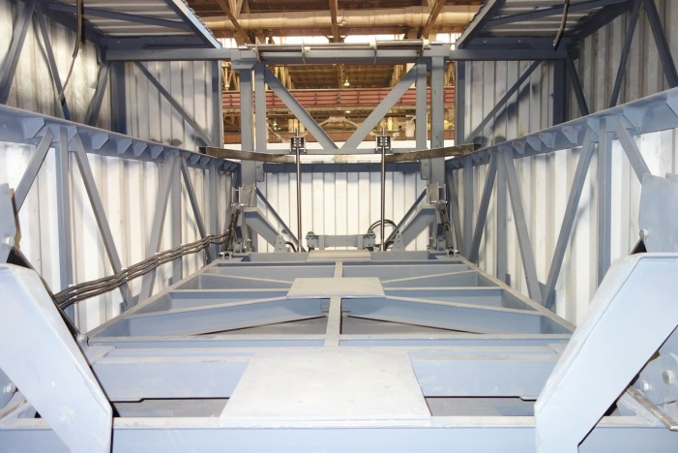
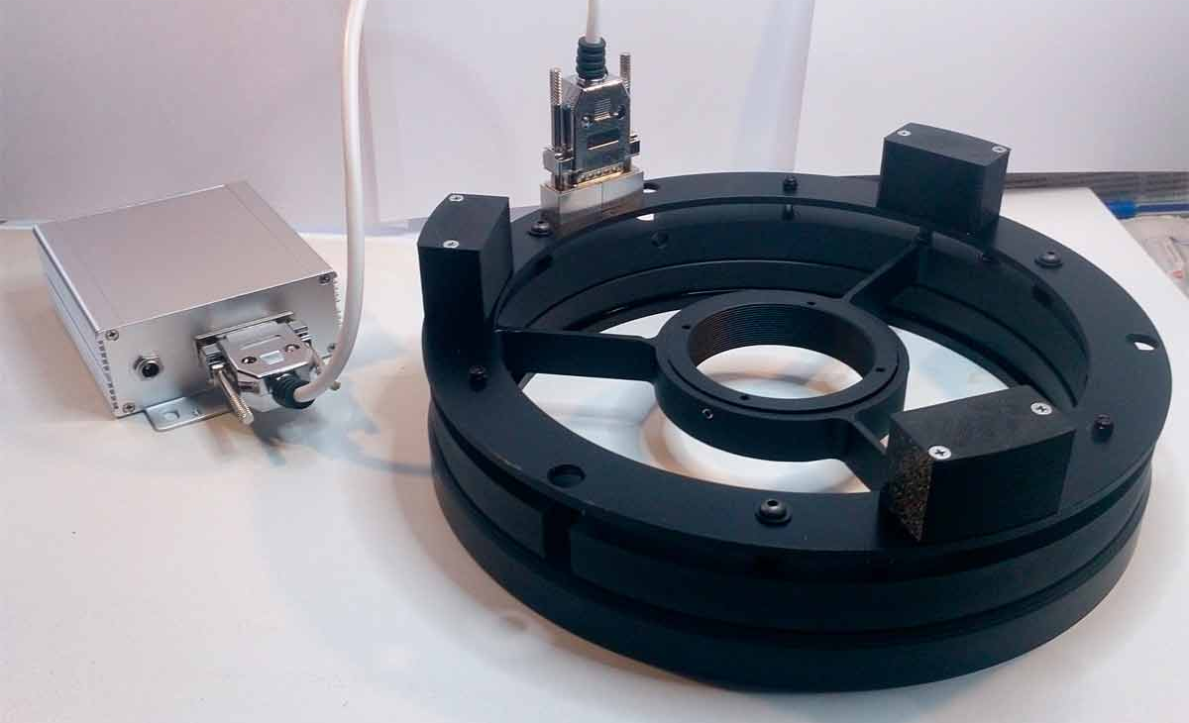
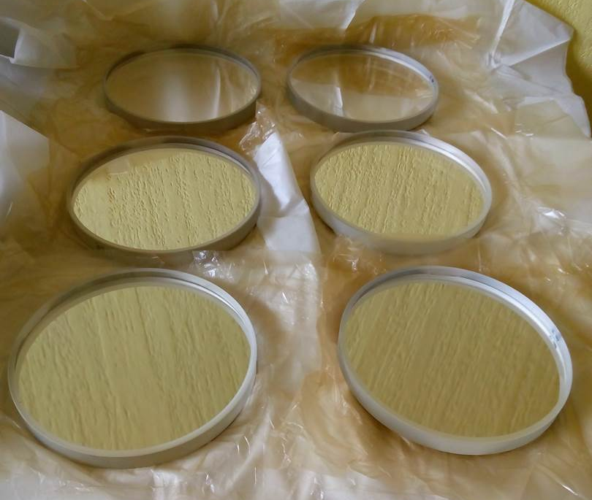
Prototype of barrier optical telescope for detection of LEO and HEO (in perigee) 20 cm x 6 with common FOV 42 x 4.5 degr., photometry 6 Hz

Slide 13
Conclusions
ISON network is splitting on 3 segments that may be independent in near future:
- KIAM scientific international cooperation;
- Roscomsos segment (ASPOS OKP);
- industry organizations (JSC Vimpel & ASC)
New segment of ISON network for observations under commercial contracts is arranged as part of KIAM cooperation
13 new telescopes are installed/involved in observations (3 for Roscosmos, 4 of scientific cooperation, 2 of industry and 4 for commercial segment), including MMT-9 that provides fast photometry observations of bright LEO objects (10.5 star magnitude)
Quantity of ISON telescopes in Western Hemisphere is allowing already to provide the conjunction analysis at GEO
New ISON telescope elaborations are carried out – series of 40 cm telescopes with FOV 5.5x5.5 degree and prototype of barrier telescope 20 cm x 6 with FOV 42 x 4.5 degree for detection of LEO&HEO objects are in producing

