Slide 1
THE ARAB CONFERENCE ON ASTRONOMY & Geophysics
ACAG8
International ISON project & database on space debris
Igor Molotov
Keldysh Institute of Applied Mathematics RAS, Moscow, Russia
Small Innovation Enterprise “ISON Ballistic-Service”, Moscow, Russia
im62@mail.ru
October 9 -12 ,2023, NRIAG, Cairo-Egypt

Slide 2
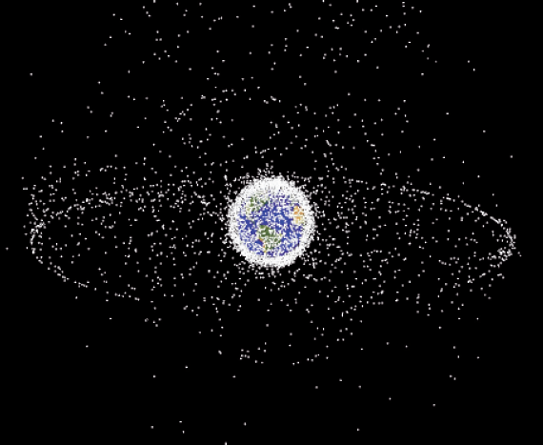
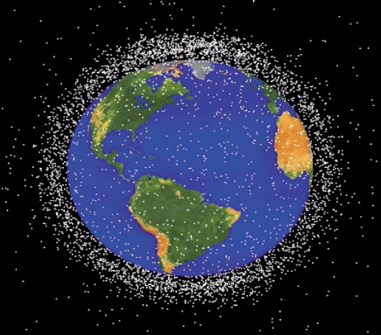
Space Debris – the problem caused by space exploration
GEO, HEO, MEO
LEO
All non-functional artificial space objects
Including upper stages , non-functional spacecrafts, operational fragments, fragments of breakups
About 37000 objects of size > 10 cm
About 80000 objects of size > 1 cm
100 million pieces smaller than 1cm

Slide 3
Space Debris topic is on crossing of interests
Science – space debris has anthropogenic origin, but his population is developing in accordance with the laws of nature and therefore such development is topic of science
Diplomacy – elaboration of measures to minimize space debris origin, elaboration of the rule of behavior in space in the case of problems caused by space debris and satellites (collisions, re-entering), keeping possibilities to use space for future generations
Space industry - protection and security of the spacecrafts, minimizing the causes of its failure, conjunction analysis, forecast of re-entering
Military – evaluation of space situation

Slide 4
Studying of the space debris phenomenon
Traditional dividing of direction of the studying the problem:
Observations (deterministic and statistical) and revelation of the space debris sources
In situ (installation of targets on satellites and the counting of quantity of impacts)
Modeling (theories of object moving and models of spatial distribution, evolution of space debris population and long-term prognosis of state taking into account various scenarios of space activity)
Main instrument is maximally full catalogue of objects – list of daily updated orbits and the ISON project is initiative attempt to create such catalogue for high orbits

Slide 5
ISON network of optical telescopes
ISON has started in 2004 as open international voluntary project on self-financing basis to be an independent source of space surveillance data for scientific and applied goals
ISON project milestones:
2004-2006: stage of project foundation, scientific goals, coordination from Pulkovo observatory, arranging the network with old telescopes, international partnership;
2007-2010: stage of project expansion, scientific goals, coordination from KIAM RAS, start of own telescopes production, development of standard ISON software, arranging of global survey system with overlap of all longitudes;
2011-2018: stage of collaboration with Roscosmos, rather applied goals, elaboration and deployment of 6 dedicated observatories, establishing the SIE “ISON Ballistic-Service”;
2019- now: stage of rebranding, applied project with a scientific component, coordination from SIE “ISON Ballistic-Service”, initiative on international centre for the exchange of information on space debris, arranging of data exchange

Slide 6
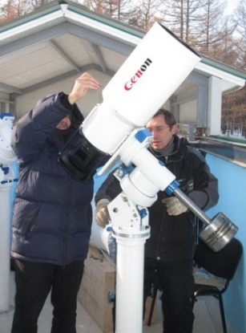
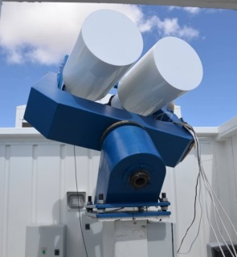
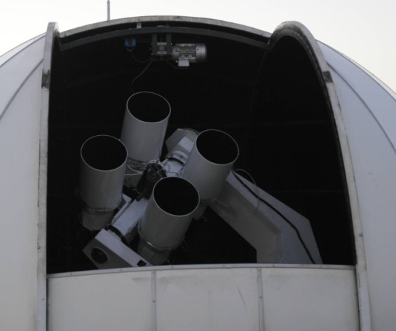
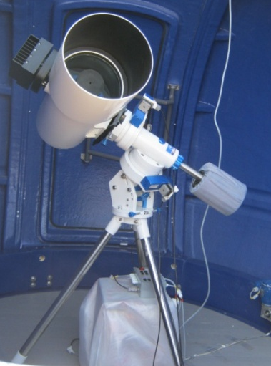
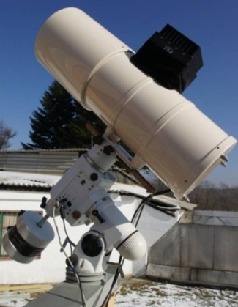
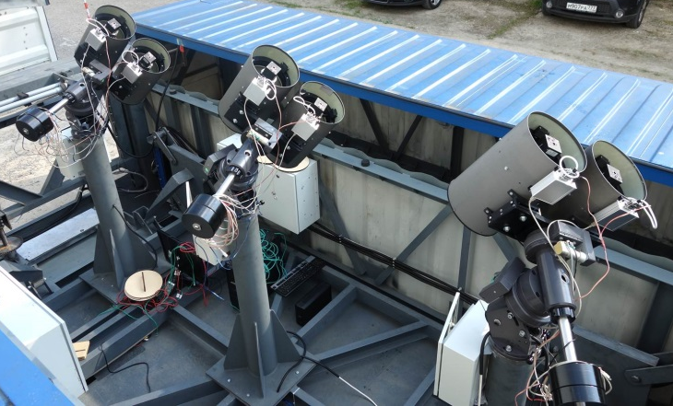
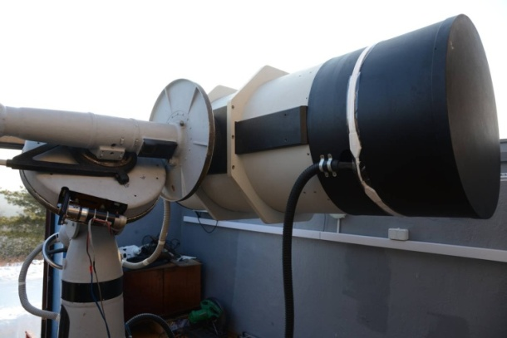
ISON survey telescope building
ISON ordered or participated into elaboration of few series of telescopes with FOV 2.5x2.5, 4x4, 7x7, 9x14, 3.5x42 degrees, mounts, domes, pavilions, focusers etc…:
Genon (Schenker 19.2 cm, 2x19.2 cm, 4x19.2 cm, Hamilton 22 cm, 25 cm, 40 cm, 50 cm), SanTel (Hamilton 40 cm, 65 cm), DISON (Hamilton 20 cm)

Slide 7
8 dedicated space debris mini-observatories of Roscosmos: 4 EOP-1, 4 EOP-2 (8x19.2 cm system, 4x25 cm, 8x 40 cm and 4x65 cm telescopes) to improve conjunction assessment analysis

Slide 8
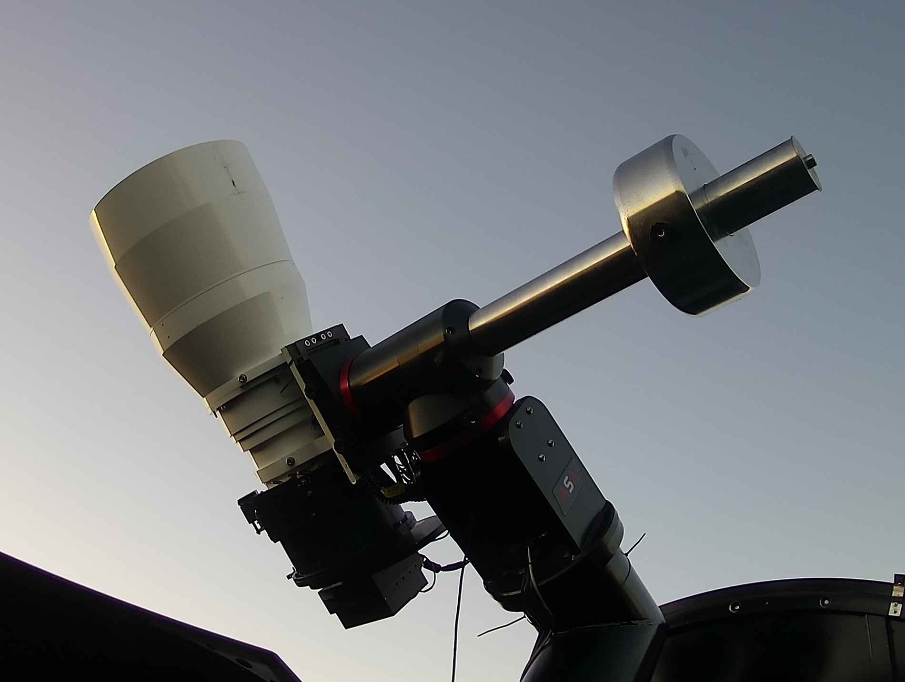
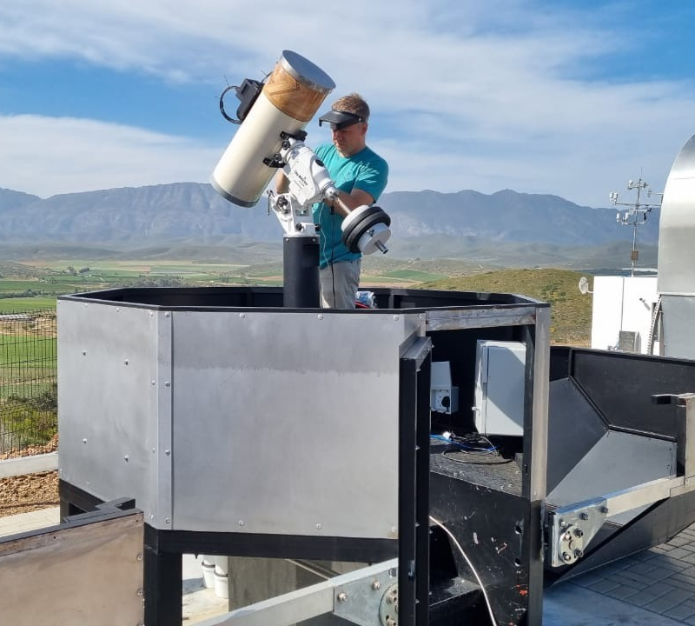
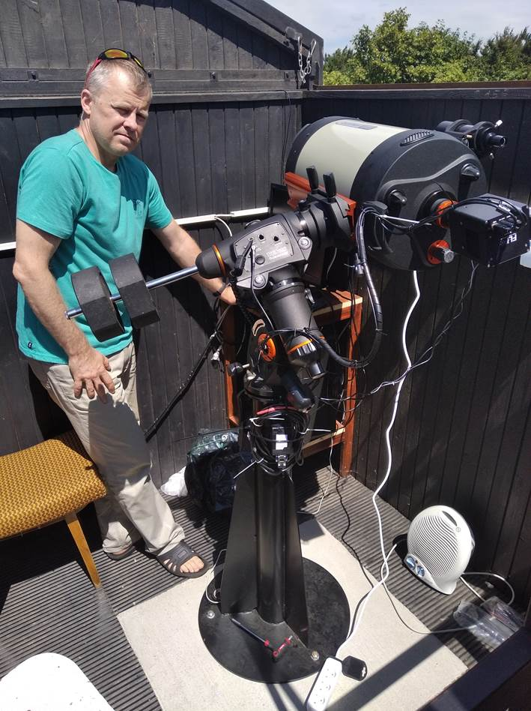
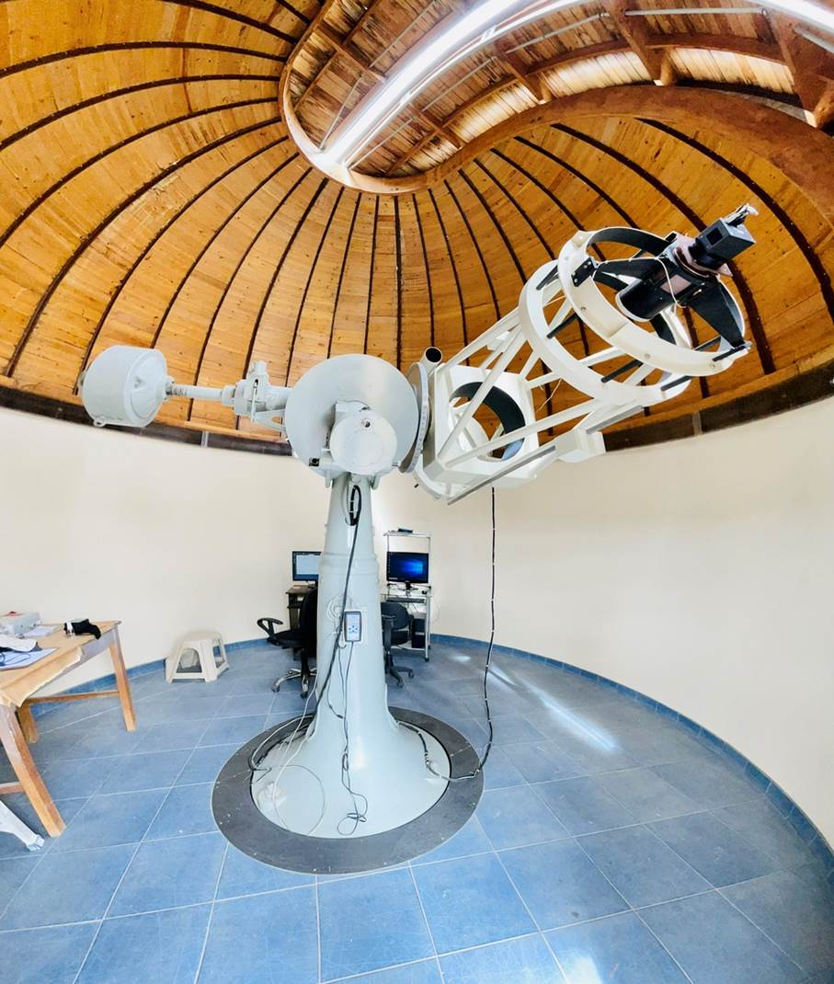
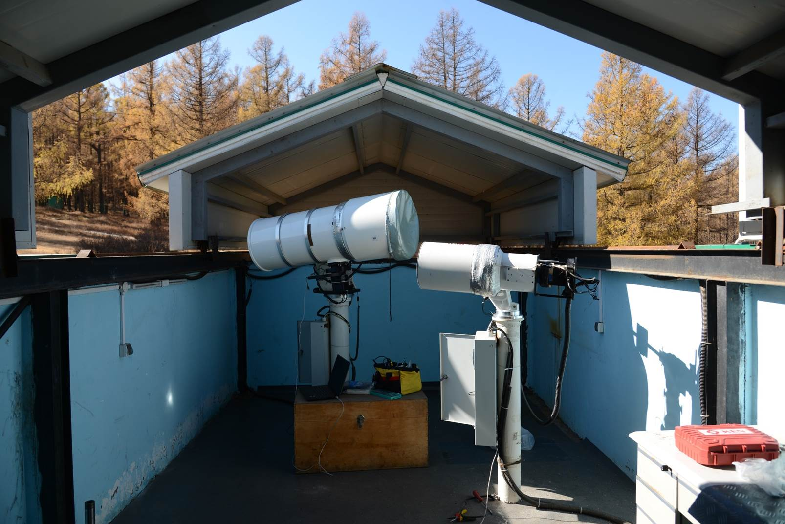
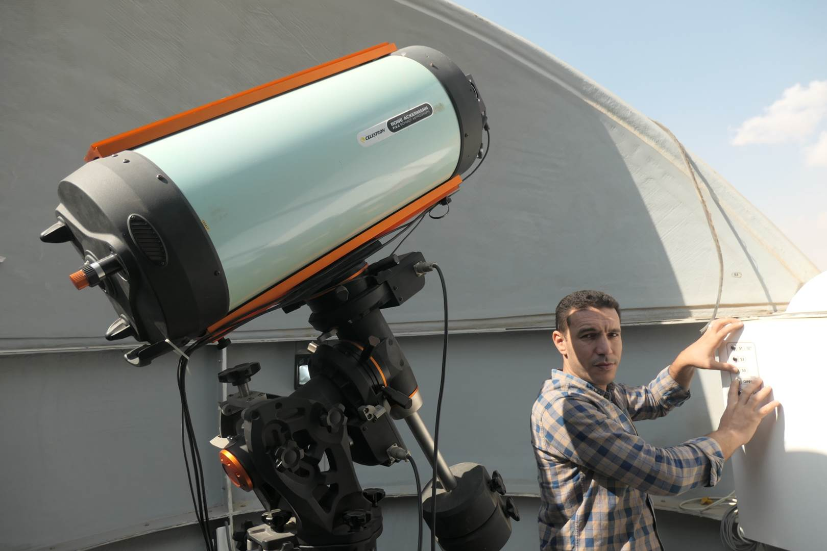
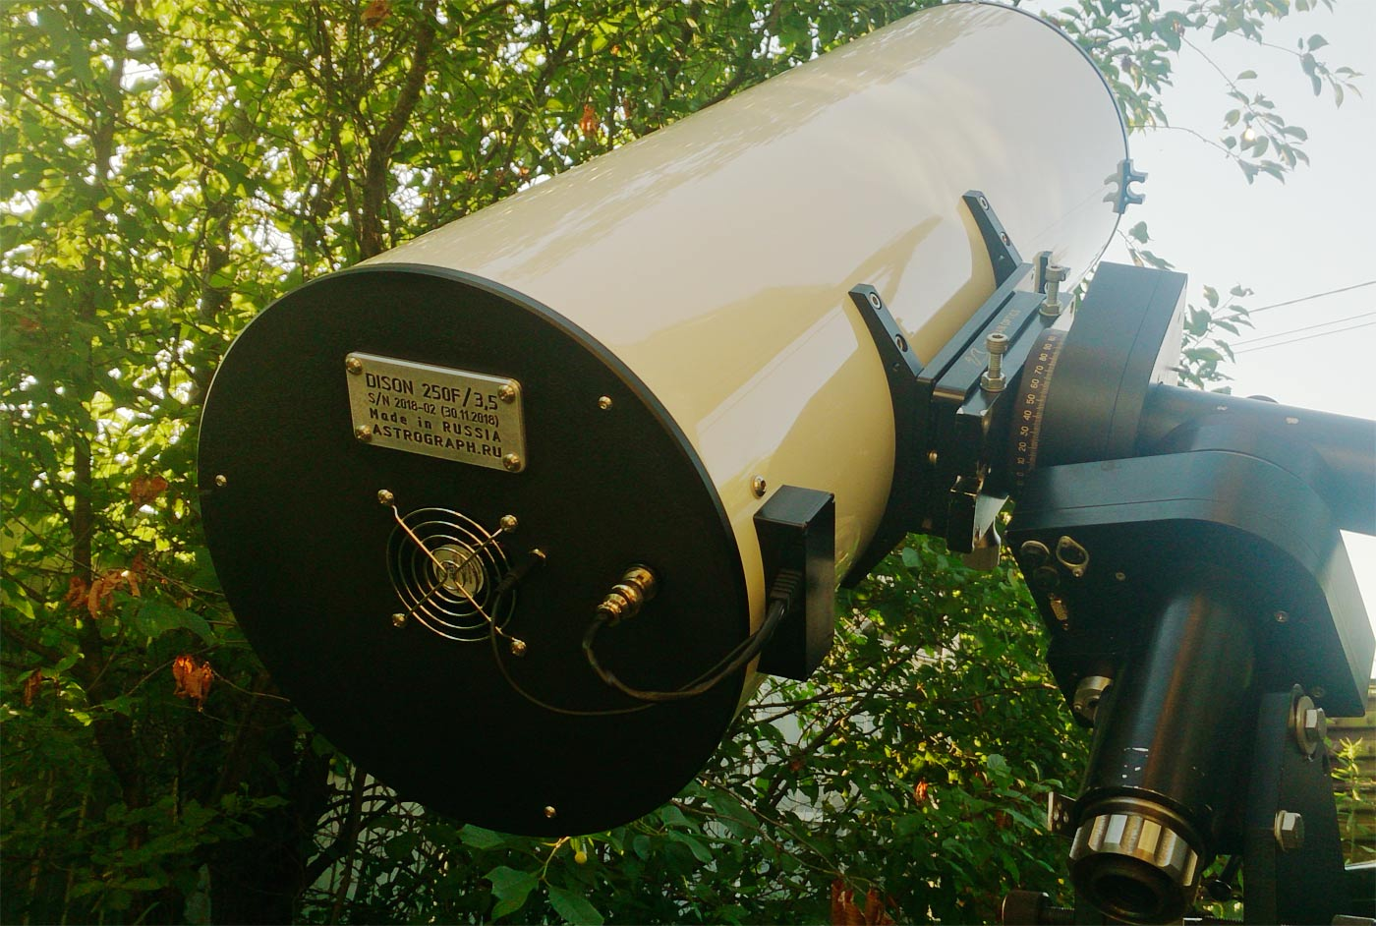
New stage of ISON development: 22-cm telescope in South Africa, 28-cm telescope in Slovakia, 60-cm and 25-cm telescopes in Bolivia, 28-cm telescope in China, 40-cm and 20-cm telescopes in Mongolia, 25-cm telescope in Mexico, 25-cm telescope for Spain, workshop building

Slide 9
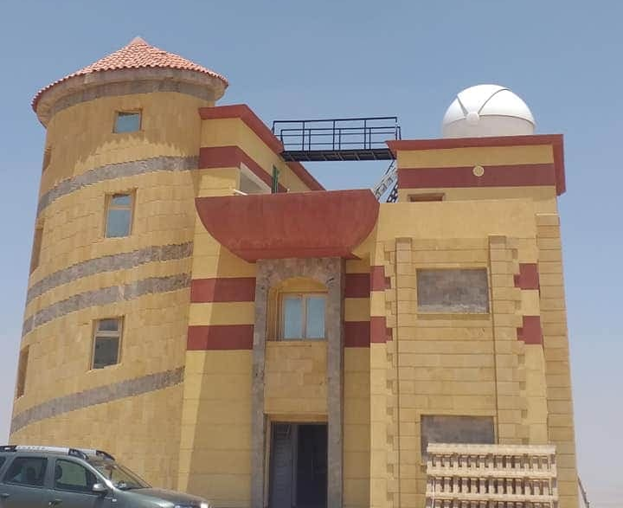
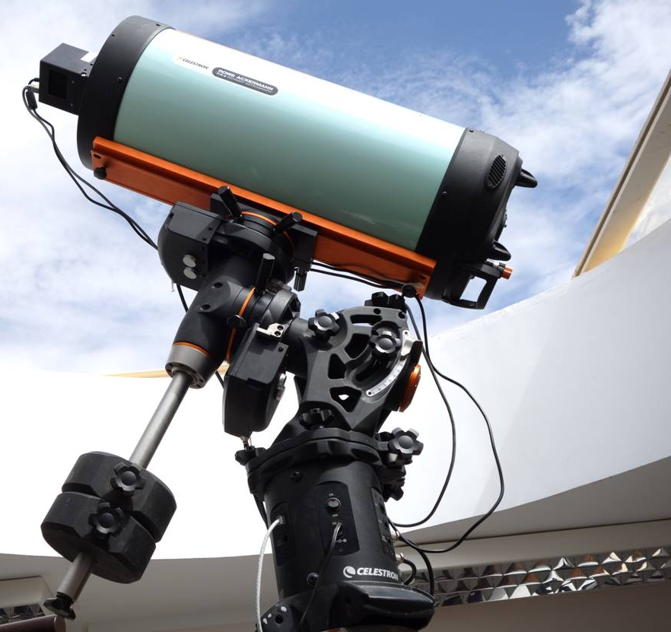
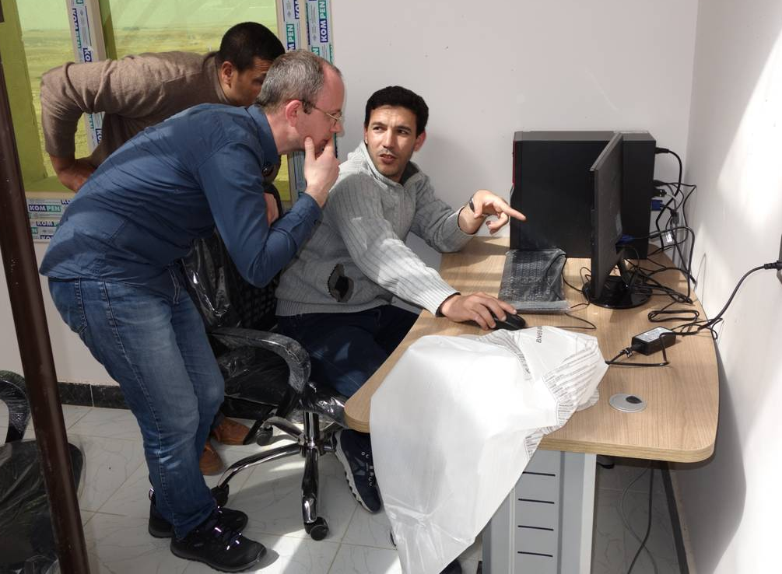
Start of ISON cooperation with Kottamia Astronomical Observatory, NRIAG
28-cm telescope with FOV 3.3x2.2 degree
80 km from Cairo (to Suez direction), height above sea level 450 m.
July 2017 signing NRIAG/KIAM agreement (finished in 2021)
March 2018 installation of ISON software and first tests
April 2019 first GEO survey
NRIAG/ISON BS agreement is under signing

Slide 10
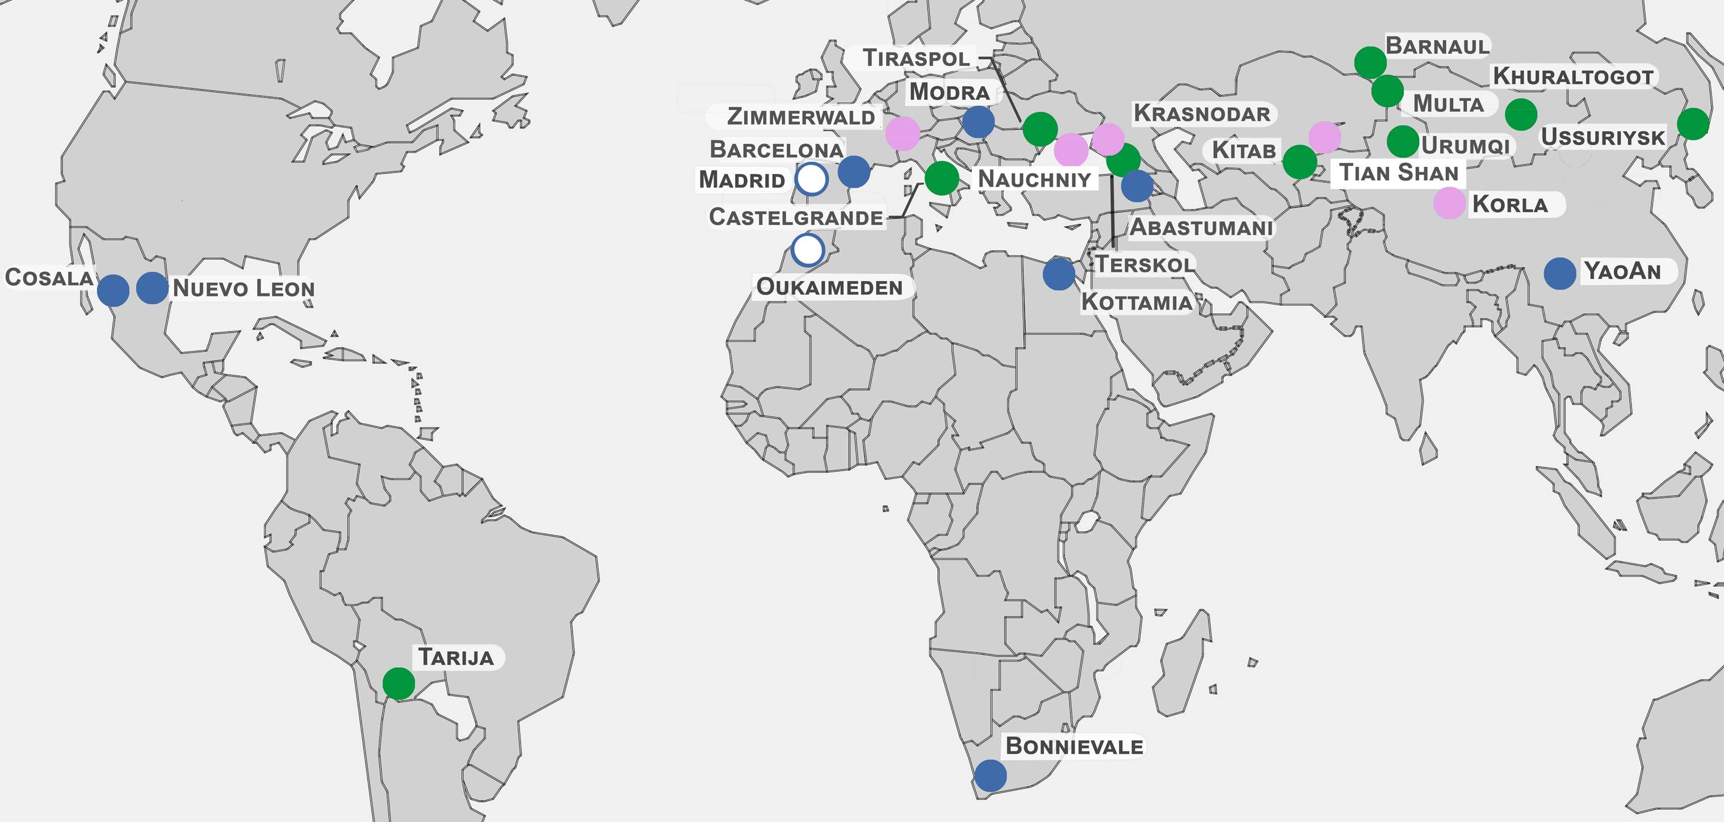
Current map of the ISON network
Green color – working observatories, Blue – stopped observatories, Violet – partner observatories

Slide 11
Space debris works with ISON
Observations:
global surveying of whole GEO orbit;
tracking of bright GEO, HEO and MEO objects;
searching and follow up of faint debris objects.
Goals:
Maintenance of the maximally full space debris database;
Support of the daily updated list of orbits of space objects to provide the conjunction assessment analysis;
Developing the space debris population model at high orbits;
Backing of the International centre for the exchange of measurement and orbital information on space debris;
Observation and orbit determination service under commercial requests.

Slide 12
Main structure of the new database in ISON-BS
Total database exceeds 127 million entries and takes up more than 45 Gb of disk space
Total orbits: 31 421 880
Total measurements: 96 333 409 (150 000 daily in average)
Total tracklets: 9 750 341
3122 GEO-objects,
5267 HEO-objects,
1697 MEO-objects.
3226 HAMR-objects,
739 operating satellites

Slide 13
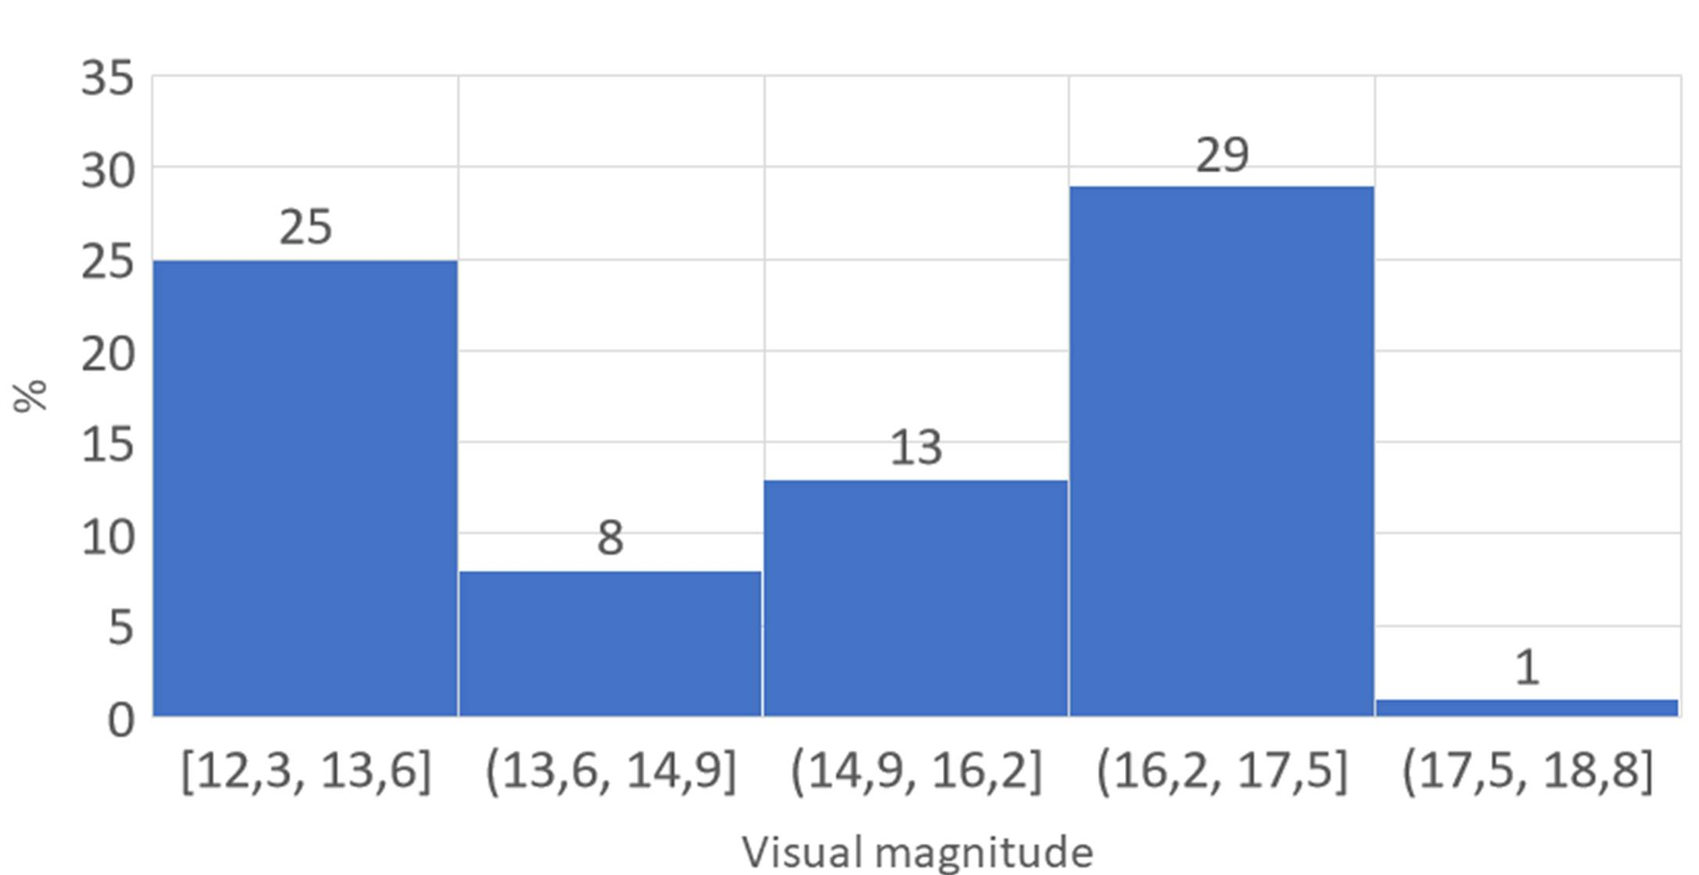
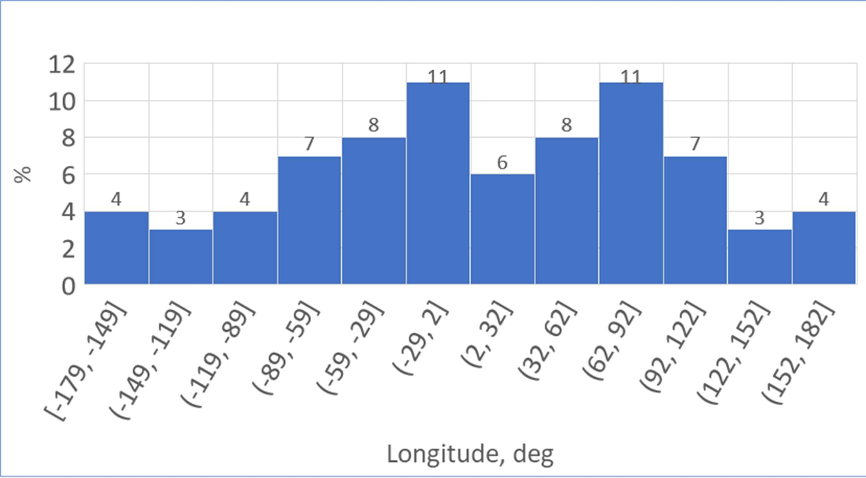
Distribution of 96 mln. measurements by visual magnitude – in %
Distribution of 1165 GEO-objects with accurate orbits by longitude – in %

Slide 14
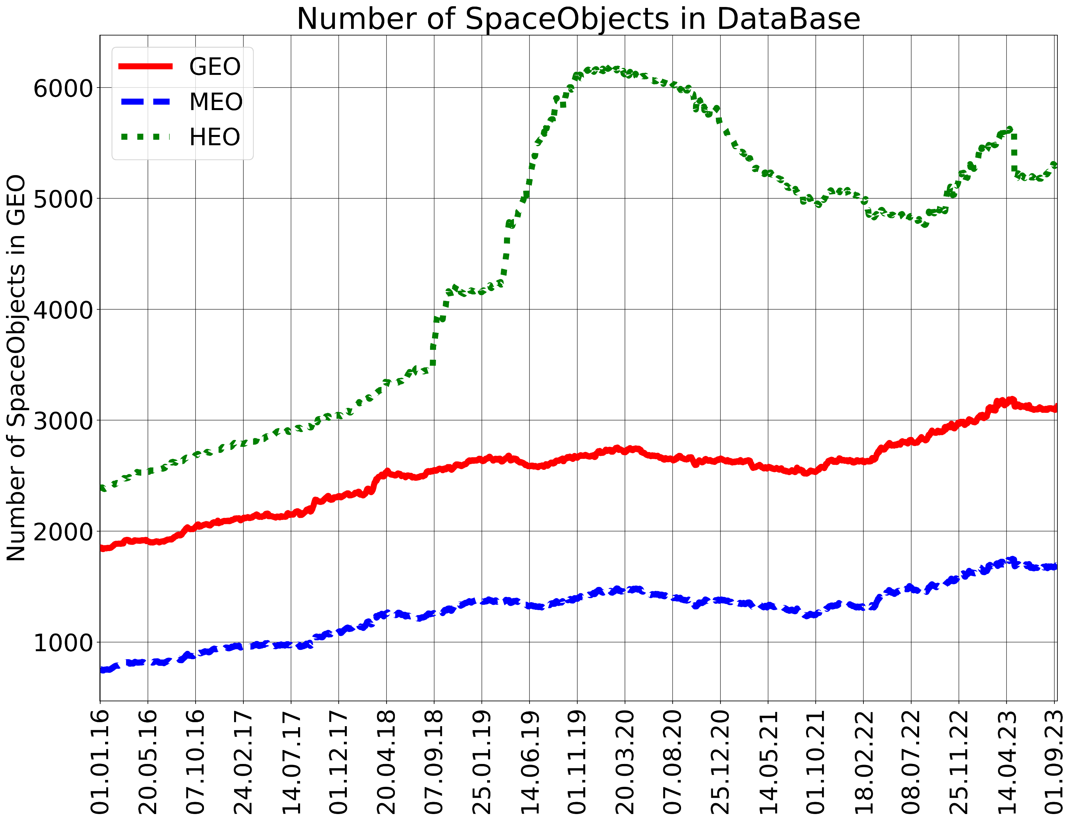
Number of objects at high orbits in database by year
On Sept. 1, 2023:
3122 GEO-objects,
5267 HEO-objects,
1697 MEO-objects.

Slide 15
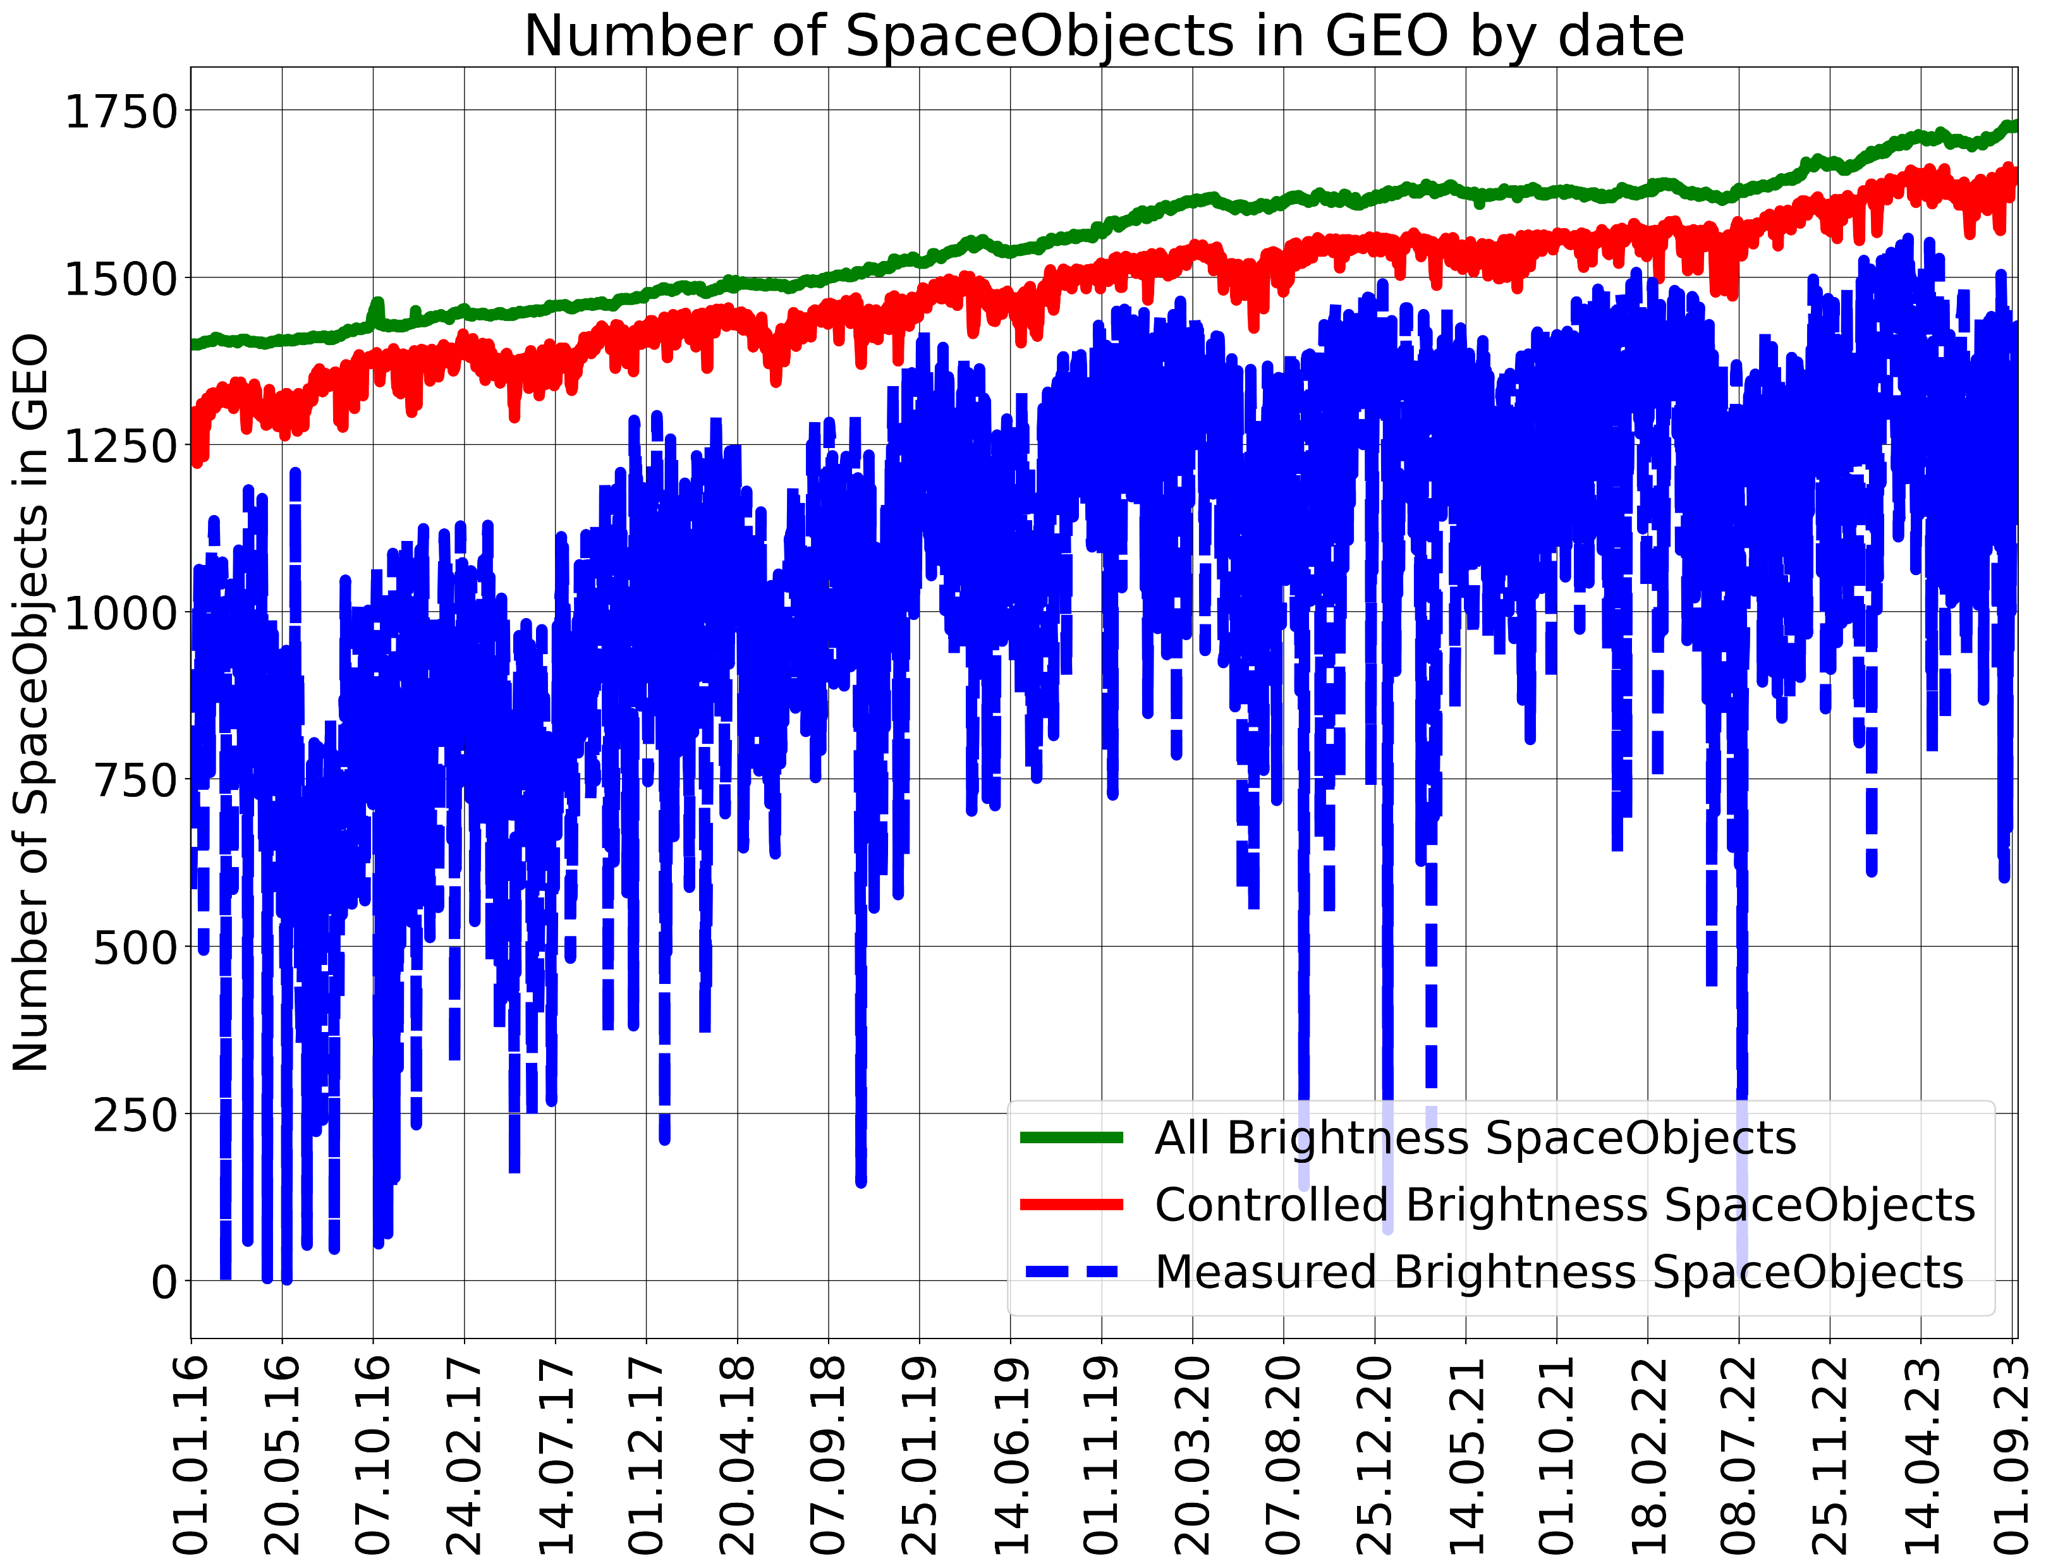
Parameters of the database of bright GEO-objects
Measurements for 90% population of bright GEO objects are regularly obtained. Accurate orbits are maintained for 98% population that is necessary condition for reliable conjunction assessment analysis. Error of 0.1 minute along the object’s orbit was chosen as the criterion for orbit accuracy.

Slide 16
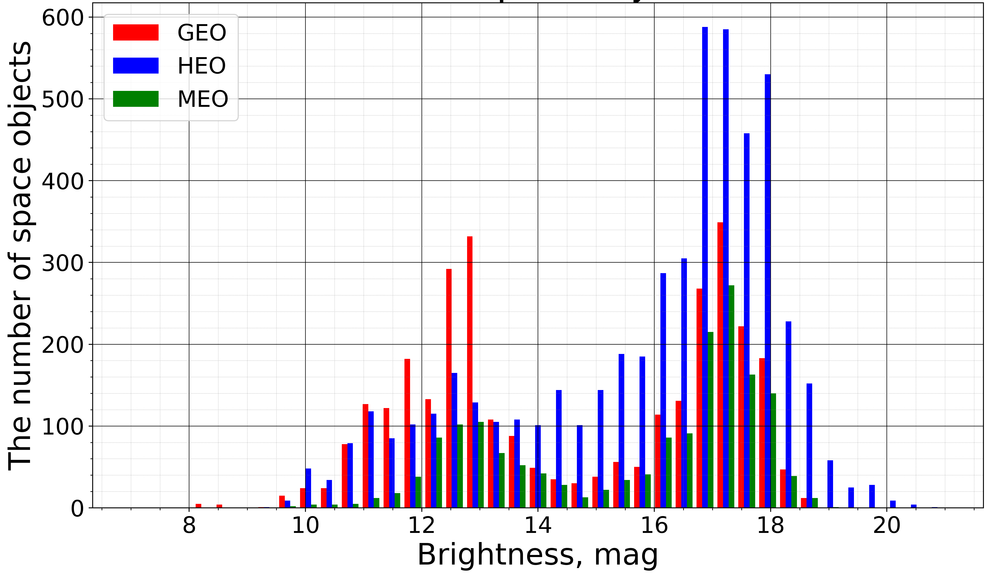
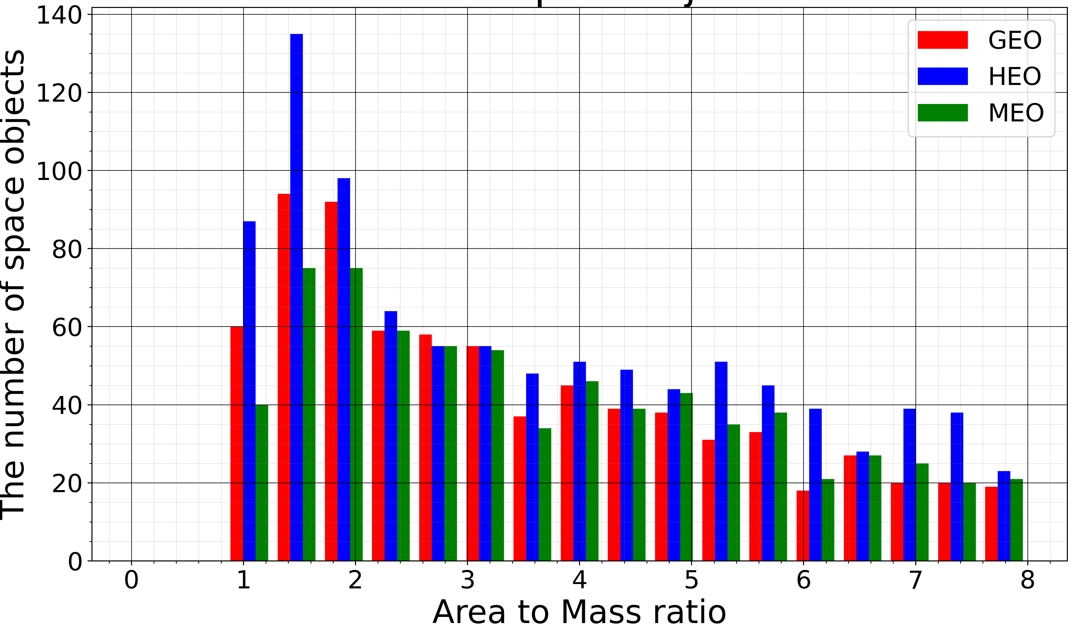
Distribution of 10086 objects at high orbits in database by brightness
Distribution by AMR for 3226 objects with AMR > 1 m2/kg at high orbits

Slide 17
Conclusion
Large civilian optical telescopes network was created during 15 years. It includes about 50 telescopes in 25 observatories. Since 2019 he ISON is operating under SIE ISON Ballistics-Service
Agreements on partnership were signed with 3 new observatories and 5 Universities during last 3 years. The cooperation with the Chinese Academy of Sciences is strengthening.
It were elaborated new software for observation scheduling, telescope control and database for collecting and analysis of the measurements and orbital information.
ISON project turning into an international centre for the exchange of information on space debris. It allowed to significantly increase the volume of measurements entering to the database (96 333 409 measurements to Sept. 1, 2023).
ISON started the cooperation with Kottamia Astronomical Observatory, NRIAG.

